Slide 1
网络认证技术04-1 Shared-Secret Based Entity Authentication

Slide 2
上节回顾：基于口令的鉴别
适用于鉴别“人”的场景
通过“输入口令”方式
简单方便
依赖于记忆，复杂度有限
容易受到猜测、窃听、重放等攻击

Slide 3
Overview
Goals for entity authentication
Focus on Shared-Secret Based entity Authentication
Two parties
Based on Symmetric algorithms
Shared secret指的是长秘密信息、不能穷举
相应的协议，就会比口令协议简单/计算量小
假设利用了其它的方式获得了Shared secret
安全信道、线下传递（如，U盘、光盘）等
Notes:
两部分内容

Slide 4
本课的目标
介绍几种常见的鉴别方式
然后，指出其中存在的攻击
揭示问题：
安全并不容易做到！

Slide 5
从实体鉴别谈起—— Goals for Entity Authentication
Basic definitions for entity authentication
ISO Security Architecture defines entity authentication as “the corroboration that an entity is the one claimed”
Menezes et al. give a more comprehensive definition
“Handbook of Applied Cryptography”. CRC Press, 1997
Entity authentication is the process whereby one party is assured (through acquisition of corroborative evidence) of the identity of a second party involved in a protocol, and that the second has actually participated.

Slide 6
Next we focus on…
Two-party entity authentication protocols without key establishment
Based on symmetric algorithms
The cryptographic keys available
The two parties already share a secret key
We will analyze several prominent examples
Notes:
单纯进行实体认证，而不进行密钥建立的协议比较稀少

Slide 7
基础知识回顾 -- 对称密码
对称密码算法Symmetric Cryptography
加密和解密的密钥Key是一样的
或者说，一个密钥能（很容易）从另一个密钥中导出
密钥
密文
明文
加密
解密
明文

Slide 8
Bird-Gopal-Herzberg-Janson-Kutten-Molva-Yung Protocols 1/10
“Systematic design of a family of attack-resistant authentication protocols”
By IBM researchers in 1993
IEEE Journal on Selected Areas in Communications
One of the first to demonstrate a wide class of attacks on several authentication protocols
Develop a set of security criteria to avoid such attacks
Start with a basic protocol

Slide 9
Bird-Gopal-Herzberg-Janson-Kutten-Molva-Yung Protocols 2/10
Simple-minded Cryptographic Authentication
A simple representation of the nonce-based authentication protocol
Nonce:一个只被使用一次的任意或非重复的随机数值
抗重放攻击 Replay Attack
Notes:
Nonce: number once fffffffff

Slide 10
Bird-Gopal-Herzberg-Janson-Kutten-Molva-Yung Protocols 3/10
Protocol 2-1 allows B to authenticate A
Protocol 2-2 allows Mutual authentication
是否存在被攻击的风险？？？
Protocol 2-1
1．B→A: E_{k}(N)
2．A→B: N
Protocol 2-2
1． A→ B: E_{k}(N₁)
2．B → A : N₁, E_{k}(N₂)
3. A→ B : N₂
Pre-shared secret：k
Notes:
f

Slide 11
Bird-Gopal-Herzberg-Janson-Kutten-Molva-Yung Protocols 4/10
Protocol 2-1
1．B→A: E_{k}(N)
2．A→B: N
Protocol 2-2
1． A→ B: E_{k}(N₁)
2．B → A : N₁, E_{k}(N₂)
3. A→ B : N₂
Attack on Protocol 2-2
A在替攻击者解密信息
Oracle Session Attack on Protocol 2-2
1． I_{A} → B: E(N₁)
2． B → I_{A} : N₁, E(N₂)
1*. I_{B}→ A : E(N₂)
2*. A → I_{B} : N₂ , E(N₃)
3. I_{A} → B: N₂
Notes:
fffffffffffff
注意第一个消息里面是N1不是NI
Oracle Session Attack:

Slide 12
Bird-Gopal-Herzberg-Janson-Kutten-Molva-Yung Protocols 5/10
Modify Protocol 2-2 to 2-3
A has to demonstrate his ability to decrypt the nonce; B has to demonstrate his ability to encrypt the nonce
An intruder can no longer misuse one party as an oracle ‘decryption server’
Protocol 2-3
1． A→ B: N₁
2．B → A : E(N₁), E(N₂)
3. A→ B : N₂
Notes:
fffffffffff

Slide 13
Bird-Gopal-Herzberg-Janson-Kutten-Molva-Yung Protocols 6/10
Protocol 2-3
1． A→ B: N₁
2．B → A : E(N₁), E(N₂)
3. A→ B : N₂
在协议的一个instance中，A和B分别作为发起/响应方、展示不同的能力
协议支持双向鉴别，A可同时作为发起/响应方（在不同的instance中，A分别作为发起/响应方、展示不同的能力）
攻击的前提
每一个会话使用单独的TCP处理线程，通常而言线程之间不会相互比较
实现中的合理假设（有时候就是成立）
Parallel session Attack on Protocol 2-3
1． A → I: N₁
1*． I → A : N₁
2*. A→ I : E(N₁), E(N₂)
2. I → A : E(N₁), E(N₂)
3. A→ I: N₂
3*. I→ A : N₂

Slide 14
Bird-Gopal-Herzberg-Janson-Kutten-Molva-Yung Protocols 7/10
The cryptographic expression used in the second message must be asymmetric (direction-dependent) so that its value in a protocol run initiated by A cannot be used in a protocol run initiated by B
N₁与E(N₁)的关系，应该不同于N₂与E(N₂)的关系
协议2-3是相同的——不行
Protocol 2-3
1． A→ B: N₁
2．B → A : E(N₁), E(N₂)
3. A→ B : N₂
Notes:
就是说 第二个消息，发起者不同，消息应该不同；protocol 2-3中的第二个消息，无论A和B谁是发起者，都是一样的。

Slide 15
Bird-Gopal-Herzberg-Janson-Kutten-Molva-Yung Protocols 8/10
Modify protocol 2-3 to 2-4
作为发起方 or 响应方，能力/动作不一样
引入XOR
N₁与E(N₁ xor B)的关系，不同于N₂与E(N₂)的关系
Protocol 2-4
1． A→ B: N₁
2．B → A : E(N₁ xor B), E(N₂)
3. A→ B : N₂

Slide 16
Bird-Gopal-Herzberg-Janson-Kutten-Molva-Yung Protocols 9/10
关系表面上不同，但是差不多，容易利用
Protocol 2-4
1． A→ B: N₁
2．B → A : E(N₁ xor B), E(N₂)
3. A→ B : N₂
Offset Attack on Protocol 2-4
1． A → I: N₁
1*． I → A : N₁ xor B xor A
2*. A→ I : E(N₁ xor B ), E(N₂)
2. I → A : E(N₁ xor B ), E(N₂)
3. A→ I: N₂
3*. I→ A : N₂
Notes:
抵消攻击

Slide 17
Bird-Gopal-Herzberg-Janson-Kutten-Molva-Yung Protocols 10/10
Summary
Using nonce，上面的协议全部都是
Resistance to replay attack
Avoid clock synchronization and stable counter storage issues
实际中，难以做到；所以，用nonce
Message from step 2 can never be used to derive the necessary message for step 3
Resistance to oracle session attack
Message in a protocol run initiated by A cannot be used in a protocol run initiated by B
Resistance to parallel session attack
Notes:
ffffffffffffffffff nonce抵御重放攻击

Slide 18
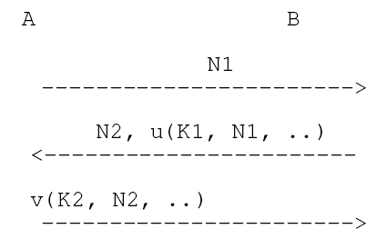
通用框架 通过nonce抵抗replay attack
K1和K2是秘密信息
u()和v()是函数
挑战者使用N1和N2
一次性随机数
抵抗replay attack
通用形式
不限定u()和v()
K1/K2可能相同或不同
对称/非对称
Notes:
fffffffffff 框架什么意思，某一些参数起什么作用 u和v k1 k2 n1 n2

Slide 19
抵抗oracle session attack
为了抵抗oracle session attack，就应该使得u()和v()函数不相同
上文中，oracle session attack就是攻击者使另一方帮自己来计算
当u()和v()不相同
攻击者就不可能让A或者B以计算u()的名义来帮自己计算v()

Slide 20
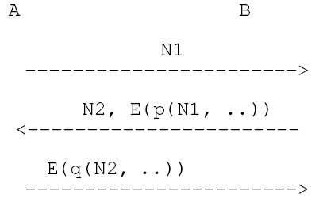
共享秘密/对称密码算法
对于对称密码算法，就是u()和v()都记为E()
相同的加密算法，例如，都基于SM4
为了使函数不相同，引入p()和q()
p()和q()是简单的变换函数
E(p(x))和E(q(x))
如下图

Slide 21
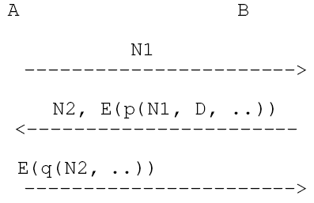
抵抗Parallel Session攻击
如何处理Parallel Session攻击？
应该使得p(), q()与方向有关
从而攻击者不能利用服务器的计算
变为如下：
其中，D表示了方向
是为发起者、还是响应者
不能发起Parallel Session攻击

Slide 22
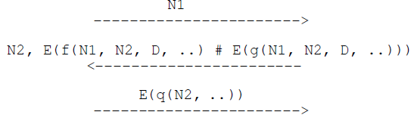
抵抗Offset攻击
Offset Attack on Protocol 2-4
1． A → I: N₁
1*． I → A : N₁ xor B xor A
2*. A→ I : E(N₁ xor B ), E(N₂)
2. I → A : E(N₁ xor B ), E(N₂)
3. A→ I: N₂
3*. I→ A : N₂
为了发起Offset
攻击者使用p(x1)、p(x2)等，通过1个或者多个E(p())的结果来构造所需的E(q(…))以完成攻击
令p()=f()#E(g())，然后再E(p())，其中#表示某种运算（例如XOR），得到右下图
因为在p()中有E()，对于安全的对称密码算法E()，可以抵抗Offset攻击
否则，就是有线性关系
Notes:
P中有E，异或之前可以运算，而加密不能

Slide 23
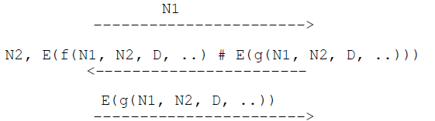
节省计算
A的计算次数少一次
直接使q()=g()
安全的、可处理上述各种攻击的基本鉴别协议形式
可以简单地认为f(x,y,z) = x|y|z；g(x,y,z)=z|y|x；#就是XOR

Slide 24
Bellare-Rogaway MAP1 Protocol 1/5
“Entity authentication and key distribution”
A landmark paper of Bellare and Rogaway
Advances in Cryptology-Crypto’ 93
Full version at http://www-cse.ucsd.edu/users/mihir
MAP1 mutual authentication protocol
Showed that MAP1 is provably secure
通常说的“可证安全”

Slide 25
Bellare-Rogaway MAP1 Protocol 2/5
Parallel Attack:
1．A→I: N_{A}
1*. I →A: N_{A}
2*.A →I: N_{B}, {N_{A}, N_{B}}_{KAB}
2．I→A: N_{B}, {N_{A}, N_{B}}_{KAB}
3．A→I: {N_{B}}_{KAB}
3*. I→A: {N_{B}}_{KAB}
Assumption: Adversary may only interact with sessions of the same protocol
也就是K_{AB}不会有其它的用法——非常强的假设
Another similar protocol proposed—EVE1
Protocol 3-1(MAP1)
1．A→B: N_{A}
2．B→A: N_{B}, {B, A, N_{A}, N_{B}}_{KAB}
3．A→B: {N_{B}, A}_{KAB}

Slide 26
Bellare-Rogaway MAP1 Protocol 3/5
”Provably insecure mutual authentication protocols: The two party symmetric-encryption case”
By Alves-FossIn 22nd National Information Systems security Conference,October 1999
Also provably secure －可证安全
Protocol 3-2 (EVE1)
1．A→B: N_{A}
2．B→A: N_{B}, {A, B, N_{A}, N_{B}}_{KAB}
3．A→B: {N_{B}, A}_{KAB}
Notes:
Protocol 2-1与Protocol2的唯一不同是A,B的位置换了，通过Protocol2-1可以对Protocol2(MAP1)进行攻击

Slide 27
Bellare-Rogaway MAP1 Protocol 4/5
Protocol 3-1(MAP1)
1．A→B: N_{A}
2．B→A: N_{B}, {B, A, N_{A}, N_{B}}_{KAB}
3．A→B: {N_{B}, A}_{KAB}
Protocol 3-2 (EVE1)
1．A→B: N_{A}
2．B→A: N_{B}, {A, B, N_{A}, N_{B}}_{KAB}
3．A→B: {N_{B}, A}_{KAB}
I masquerades as B in a run of the MAP1 started by A; In parallel, I starts a run of the EVE1 with A while masquerading as B
Chosen protocol Attack on MAP1
1． A → I_{B} : N_{A}
1*. I_{B}→ A : N_{A}
2*. A→ I_{B} : N_{A}*, {B, A, N_{A}, N_{A}* }_{KAB}
2. I_{B} → A : N_{A}* , {B, A, N_{A}, N_{A}* }_{KAB}
3. A → I_{B} : {A, N_{A}* }_{KAB}
Notes:
Is the attack on MAP1 valid? A reasonable conclusion may be that the attack is invalid since it violate the assumption(Adversary may only interact with sessions of the same protocol) of MAP1 protocol.In addition, the attack is a reminder that provable security does not guarantee security against chosen protocol attacks

Slide 28
攻击 vs 可证安全
可证安全的证明过程有问题？
攻击过程违背了假设
Adversary may only interact with sessions of the same protocol
K_{AB}被用到了2种不同的协议：MAP1和EVE1
SSL/TLS协议、authenticated encryption中，使用不同的key分别用于对称加密和MAC校验
Chosen protocol Attack on MAP1
1． A → I_{B} : N_{A}
1*. I_{B}→ A : N_{A}
2*. A→ I_{B} : N_{A}*, {B, A, N_{A}, N_{A}* }_{KAB}
2. I_{B} → A : N_{A}* , {B, A, N_{A}, N_{A}* }_{KAB}
3. A → I_{B} : {A, N_{A}* }_{KAB}

Slide 29
结论
一台服务器，同时支持2种“可证安全”的协议，结果导致它不安全
安全
是不是安全？相对于不同的假设条件，才能够说“安全不安全”。
可证安全是在特定的假设情况下，将协议归结到某些已知的计算难题
信息论安全（无条件安全）
可证安全
计算安全
Notes:
信息论安全：攻击者即使拥有无限的计算能力，密码系统也能保障安全性
可证明安全 (Provable Security) 是指密码学方案中在一定数学假设基础之上、在特定安全模型下可被严格证明的安全性
计算安全：用现在或者将来的可用资源下

Slide 30
ISO/IEC 9798-2 Protocols
The international standard ISO/IEC 9798-2:2019
Information technology -- Security techniques -- Entity authentication -- Part 2: Mechanisms using authenticated encryption
Previous version: using symmetric encipherment algorithms
Six protocols using symmetric encryption algorithms
Four of them provide entity authentication alone
Unilateral authentication 单向
Two are intended to provide key establishment as well as entity authentication
Mutual authentication 双向
We firstly examine these protocols with some optional text fields omitted
Authentication protocols involving 2 parties

Slide 31
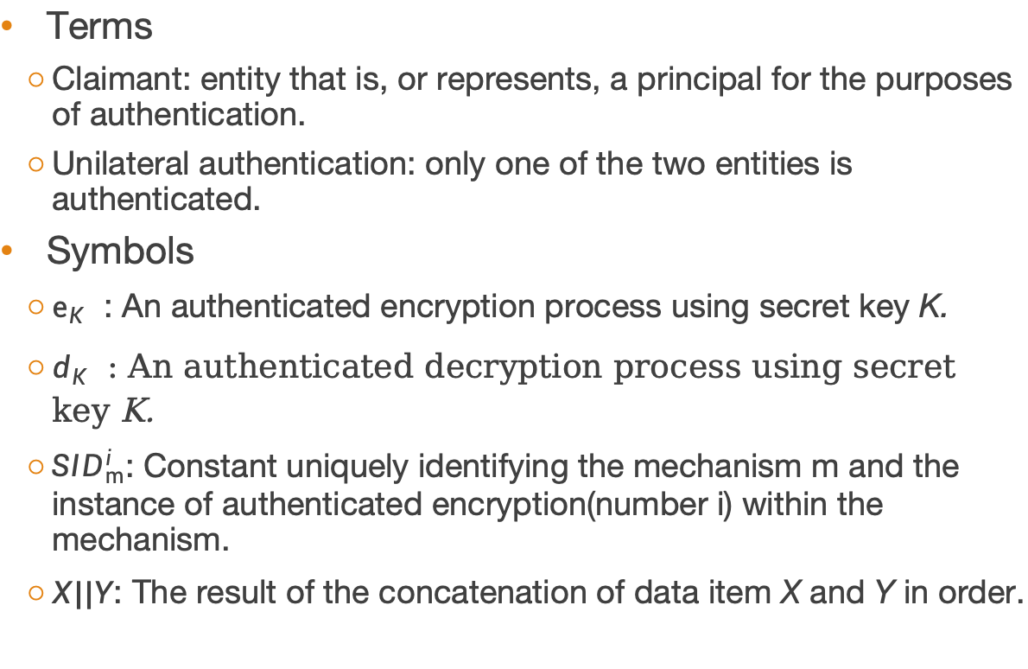
ISO/IEC 9798-2 Protocols
Terms
Claimant: entity that is, or represents, a principal for the purposes of authentication.
Unilateral authentication: only one of the two entities is authenticated.
Symbols
$e_{K_{}}$: An authenticated encryption process using secret key K.
$d_{K_{}}\text{: }\text{An} \text{authenticated} \text{decryption} \text{process} \text{using} \text{secret} \text{key} \text{K}\text{.}$
${SID}_{m}^{i}$: Constant uniquely identifying the mechanism m and the instance of authenticated encryption(number i) within the mechanism.
$X||Y$: The result of the concatenation of data item X and Y in order.
Notes:
A to B unilateral entity authentication
The timestamp T_{A} allows B to deduce that A is live. The inclusion of the identity B ensures that A has knowledge of B are her peer entity.
要求时间同步
fffffffff

Slide 32


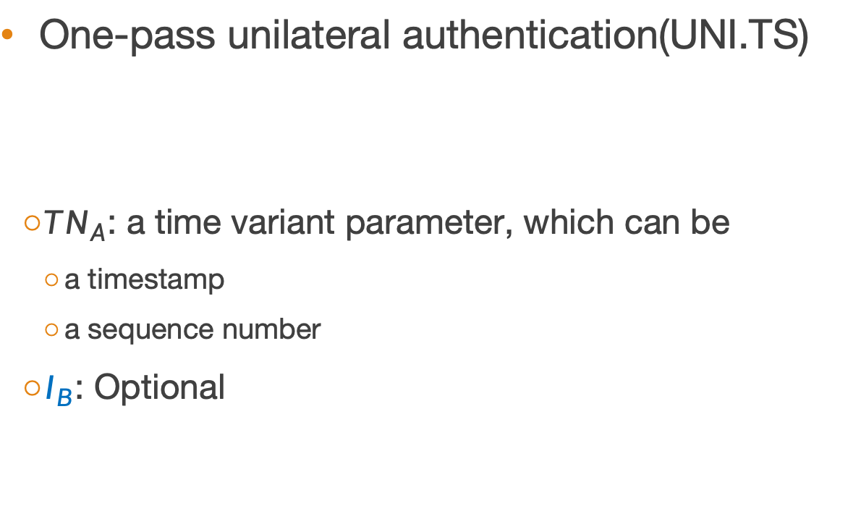
ISO/IEC 9798-2: UNI.TS
One-pass unilateral authentication(UNI.TS)
$TN_{A}$: a time variant parameter, which can be
a timestamp
a sequence number
$I_{B}$: Optional
A
$${Token}_{AB}$$
B
$${Token}_{AB}=e_{K_{AB}}\left({SID}_{UNI.TS}^{1}||TN_{A}||I_{B}\right)$$
Notes:
Token解释下
ffffffffffffff

Slide 33




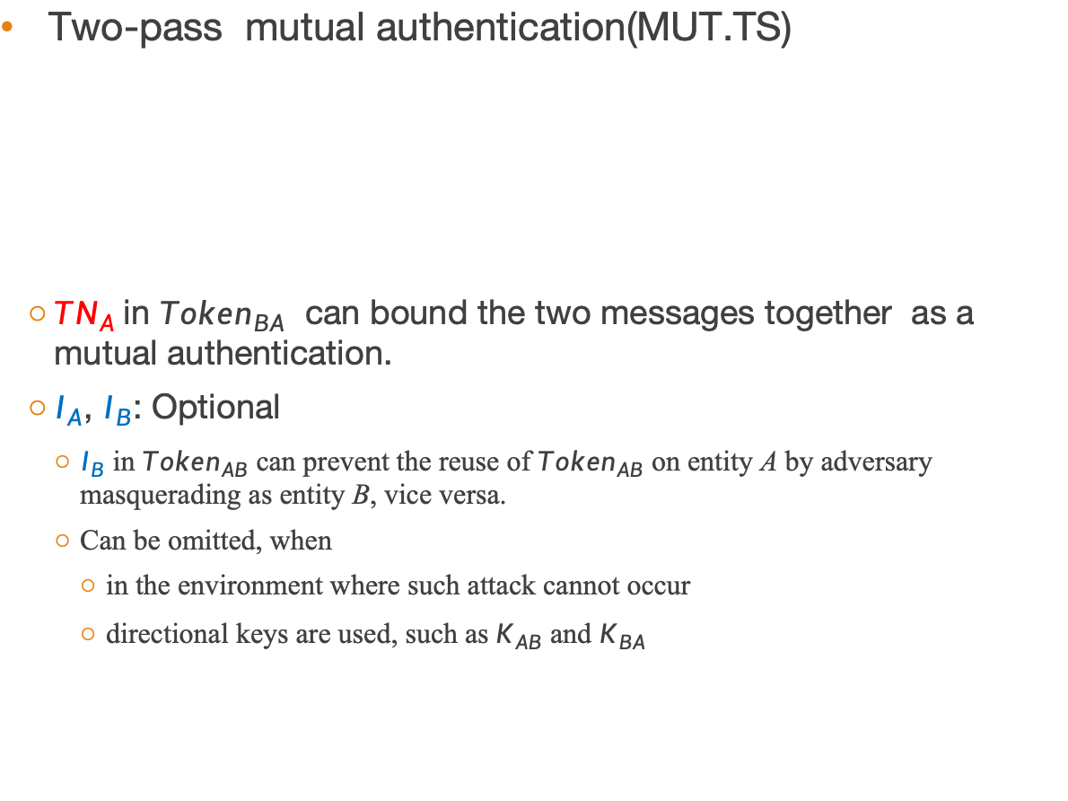
ISO/IEC 9798-2: MUT.TS
Previous version of 9798-2
1．A→B: {T_{A}, B}_{KAB}
2．B→A: {T_{B}, A}_{KAB}
Two-pass mutual authentication(MUT.TS)
$TN_{A}$ in ${Token}_{BA}$ can bound the two messages together as a mutual authentication.
$I_{A}$, $I_{B}$: Optional
$I_{B}$ in ${Token}_{AB}$ can prevent the reuse of ${Token}_{AB}$ on entity A by adversary masquerading as entity B, vice versa.
Can be omitted, when
in the environment where such attack cannot occur
directional keys are used, such as$K_{AB}$ and $K_{BA}$
$${Token}_{AB}=e_{K_{AB}}\left({SID}_{MUT.TS}^{1}||TN_{A}||I_{B}\right)$$
(1) ${Token}_{AB}$
A
B
$${Token}_{BA}=e_{K_{AB}}\left({SID}_{MUT.TS}^{2}||TN_{B}||I_{A}\right)$$
(2) ${Token}_{BA}$
$${Token}_{BA}=e_{K_{AB}}\left({SID}_{MUT.TS}^{2}||TN_{A}||TN_{B}||I_{A}\right)$$

Slide 34



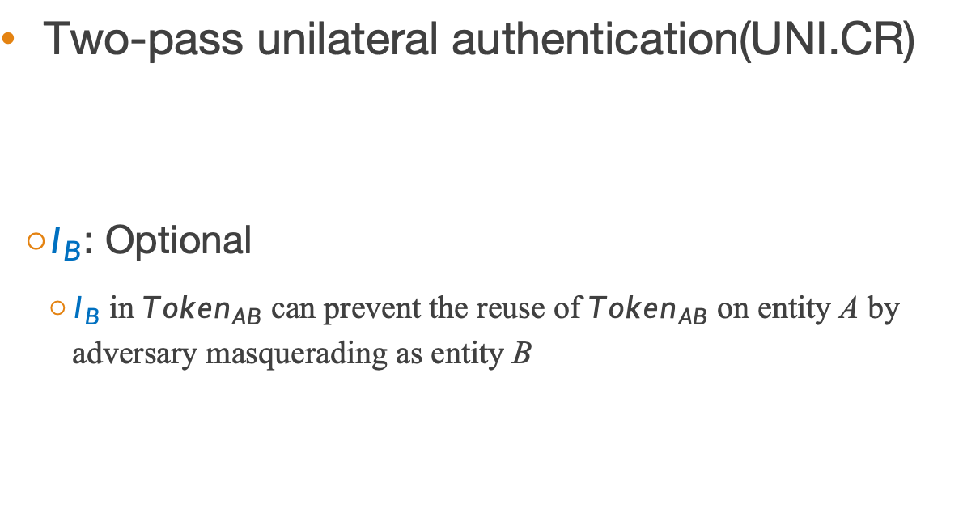
ISO/IEC 9798-2: UNI.CR
Two-pass unilateral authentication(UNI.CR)
$I_{B}$: Optional
$I_{B}$ in ${Token}_{AB}$ can prevent the reuse of ${Token}_{AB}$ on entity A by adversary masquerading as entity B
$${Token}_{AB}=e_{K_{AB}}\left({SID}_{UNI.CR}^{1}||R_{B}||I_{B}\right)$$
(1) $R_{B}$
A
B
(2) ${Token}_{AB}$
Notes:
CR: check random
fffffffffff

Slide 35


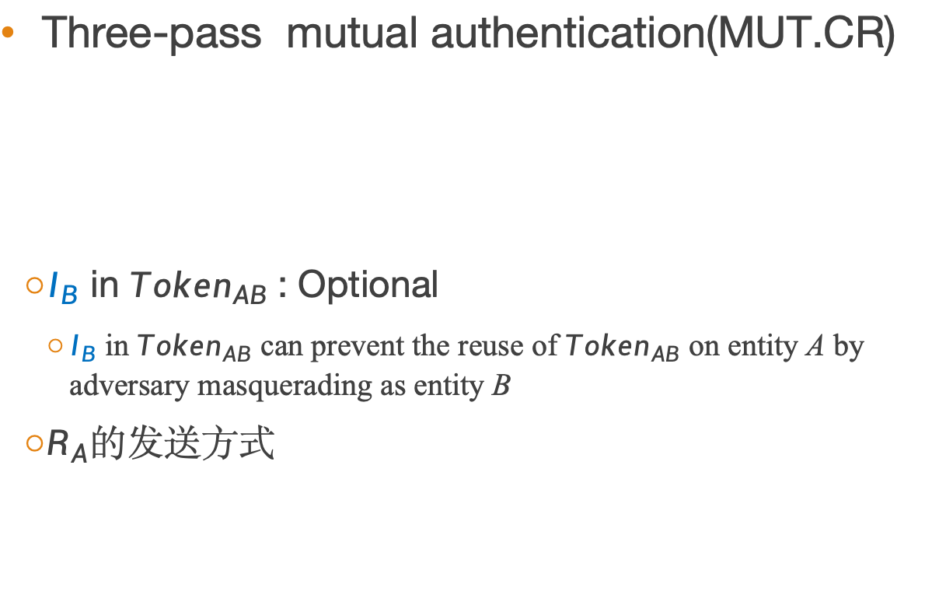
ISO/IEC 9798-2: MUT.CR
Three-pass mutual authentication(MUT.CR)
$I_{B}$ in ${Token}_{AB}$: Optional
$I_{B}$ in ${Token}_{AB}$ can prevent the reuse of ${Token}_{AB}$ on entity A by adversary masquerading as entity B
$R_{A}$的发送方式
(1) $R_{B}$
$${Token}_{AB}=e_{K_{AB}}\left({SID}_{MUT.CR}^{1}|\left|R_{A}\right||R_{B}||I_{B}\right)$$
A
B
(2) ${Token}_{AB}$
$${Token}_{BA}=e_{K_{AB}}\left({SID}_{MUT.CR}^{2}|\left|R_{A}\right||I_{B}\right)$$
(3) ${Token}_{BA}$

Slide 36
Woo-Lam Protocol 1/3
Previous entity authentication protocols assume a shared key already exists between the two principals involved
Woo-Lam protocol uses a trusted server as a key translation center
Convert messages encrypted with one key that it knows into messages encrypted with a different key

Slide 37
Woo-Lam Protocol 2/3
B Chooses his nonce N_{B} and challenges A to encrypt it with K_{AS}.
On receipt of the purported encryption, B asks S to translate it into an encryption with K_{BS}.
S
(TTP)
共享密钥K_{AS}
Protocol 5-1
1．A→B: A
2．B→A: N_{B}
3．A→B: {N_{B}}_{KAS}
4．B→S: {A, {N_{B}}_{KAS}}_{KBS}
5．S→B: {N_{B}}_{KBS}
共享密钥
K_{BS}
4
5
B
1
A
2
3
Notes:
ffffffffffff 不贡献对称密钥，通过第三方怎么传递。

Slide 38

Woo-Lam Protocol – Attack 3/3
对比
(1) $R_{B}$
A
B
(2) ${Token}_{AB}$
$${Token}_{AB}=e_{K_{AB}}\left({SID}_{UNI.CR}^{1}||R_{B}||I_{B}\right)$$
An Attack on protocol 5-1
1． I_{A} → B : A
1*. I→ B : I
2. B→ I_{A} : N_{B}
3. I_{A} → B : R
4. B → S : {A, R}_{KBS}
5. S → B : {N_{B}} _{KBS}
Protocol 5-1
1．A→B: A
2．B→A: N_{B}
3．A→B: {N_{B}}_{KAS}
4．B→S: {A, {N_{B}}_{KAS}}_{KBS}
5．S→B: {N_{B}}_{KBS}
Notes:
I发送给B的R,在正常协议中，应该是Kas加密的东西，但是B也看不了，直接转发给S

Slide 39
Woo-Lam Protocol – Attack 3/3
对比
(1) $R_{B}$
A
B
Adversary I starts two runs with B, in one of which I claims to be A.
The two protocol runs continue in parallel but I simply sends a random value R when asked to respond to the challenge intended for A.
(2) ${Token}_{AB}$
$${Token}_{AB}=e_{K_{AB}}\left({SID}_{UNI.CR}^{1}||R_{B}||I_{B}\right)$$
An Attack on protocol 5-1
1． I_{A} → B : A
1*. I→ B : I
2. B→ I_{A} : N_{B}
2*. B → I : N_{B}*
3. I_{A} → B : R
3*. I → B : {N_{B}}_{KIS}
4. B → S : {A, R}_{KBS}
4*. B → S : {I, {N_{B}}_{KIS}}_{KBS}
5*. = 5. S → B : {N_{B}} _{KBS}
Protocol 5-1
1．A→B: A
2．B→A: N_{B}
3．A→B: {N_{B}}_{KAS}
4．B→S: {A, {N_{B}}_{KAS}}_{KBS}
5．S→B: {N_{B}}_{KBS}
Notes:
I发送给B的R,在正常协议中，应该是Kas加密的东西，但是B也看不了，直接转发给S

Slide 40
ISO/IEC 9798-2 Protocols involving a third party
There’s not a shared secret between A and B.
A trusted third party (P) shares a secret with A and B, respectively, K_{AP}, K_{BP}

Slide 41





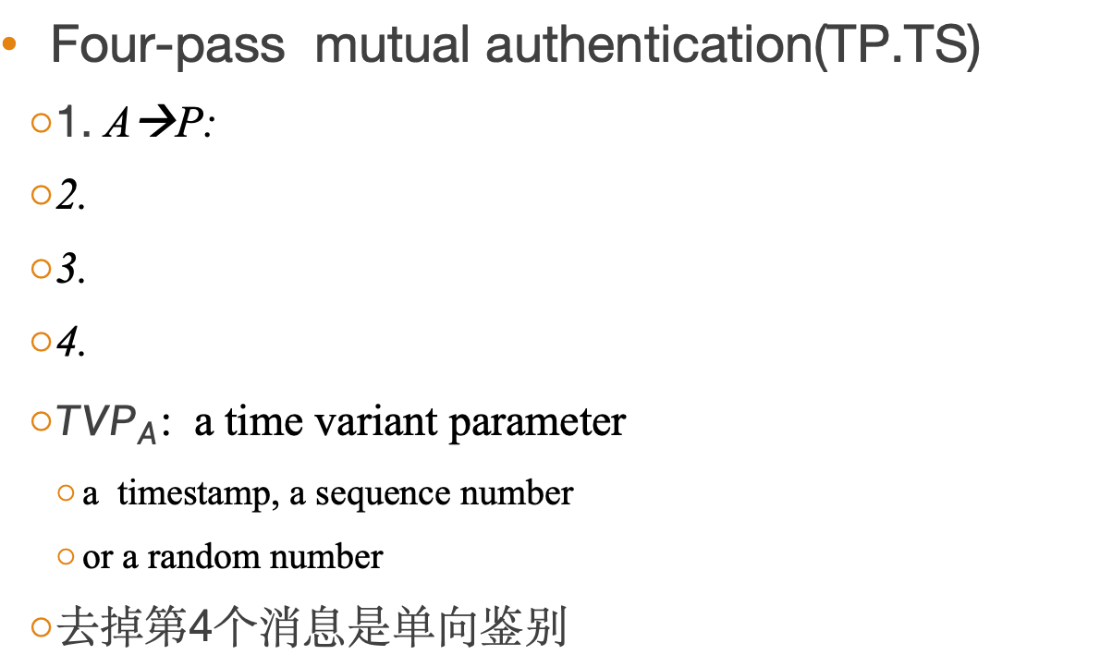
ISO/IEC 9798-2: TP.TS
Four-pass mutual authentication(TP.TS)
1. A→P:
2.
3.
4.
${TVP}_{A}$: a time variant parameter
a timestamp, a sequence number
or a random number
去掉第4个消息是单向鉴别
$${TVP}_{A}||I_{B}$$
${Token}_{PA}=e_{K_{AP}}\left({SID}_{TP.TS}^{1}|\left|{TVP}_{A}\right|\left|K_{AB}\right||I_{B}\right)$|| $e_{K_{BP}}\left({SID}_{TP.TS}^{2}|\left|{TN}_{P}\right|\left|K_{AB}\right||I_{A}\right)$
$${Token}_{AB}=e_{K_{BP}}\left({SID}_{TP.TS}^{2}|\left|{TN}_{P}\right|\left|K_{AB}\right||I_{A}\right)||e_{K_{AB}}\left({SID}_{TP.TS}^{3}||{TN}_{A}\right)$$
$${Token}_{BA}=e_{K_{AB}}\left({SID}_{TP.TS}^{4}||{TN}_{B}\right)$$
P
1
2. ${Token}_{PA}$
A
3. ${Token}_{AB}$
B
4. ${Token}_{BA}$

Slide 42





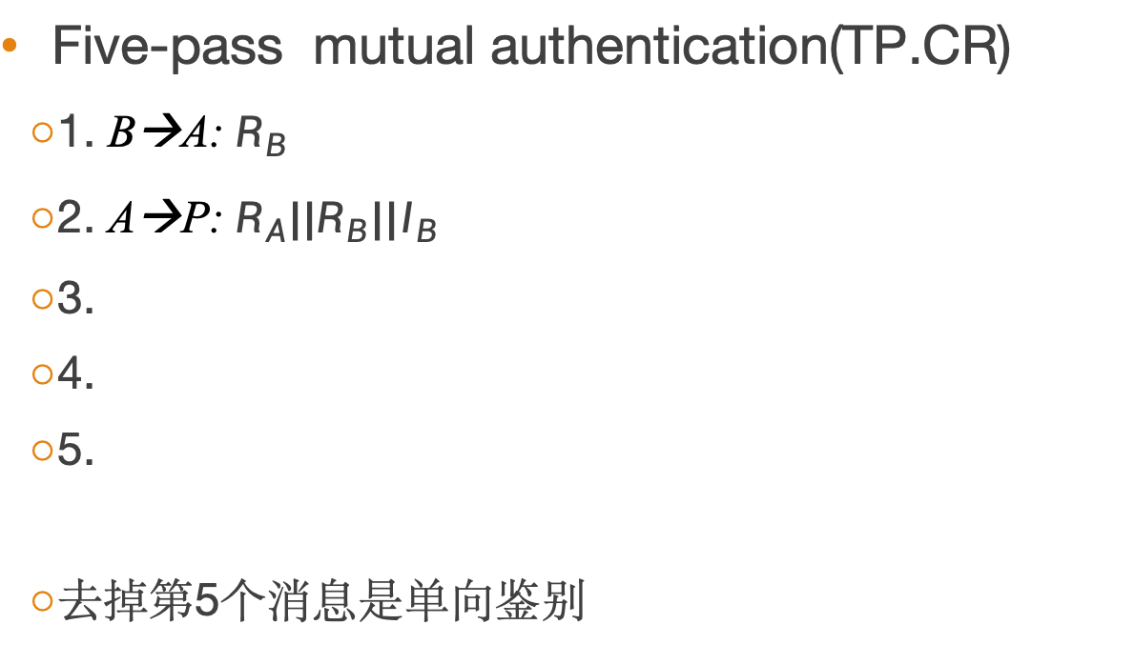
ISO/IEC 9798-2: TP.CR
Five-pass mutual authentication(TP.CR)
1. B→A: $R_{B}$
2. A→P: ${R_{A}||R}_{B}||I_{B}$
3.
4.
5.
去掉第5个消息是单向鉴别
${Token}_{PA}=e_{K_{AP}}\left({SID}_{TP.CR}^{1}|\left|R_{A}\right|\left|K_{AB}\right||I_{B}\right)$|| $e_{K_{BP}}\left({SID}_{TP.CR}^{2}|\left|R_{B}\right|\left|K_{AB}\right||I_{A}\right)$
$${Token}_{AB}=e_{K_{BP}}\left({SID}_{TP.CR}^{2}|\left|R_{B}\right|\left|K_{AB}\right||I_{A}\right)||e_{K_{AB}}\left({SID}_{TP.CR}^{3}|\left|R_{A}^{′}\right||R_{B}||{TN}_{A}\right)$$
$${Token}_{BA}=e_{K_{AB}}\left({SID}_{TP.CR}^{4}||R_{A}^{′}\right)$$
P
2
3. ${Token}_{PA}$
1. $R_{B}$
A
B
4. ${Token}_{AB}$
5. ${Token}_{BA}$

Slide 43
网络认证技术04-2 Entity authentication using digital signature techniques

Slide 44
从实体鉴别谈起—— Goals for Entity Authentication
Basic definitions for entity authentication
ISO Security Architecture defines entity authentication as “the corroboration that an entity is the one claimed”
Menezes et al. give a more comprehensive definition
“Handbook of Applied Cryptography”. CRC Press, 1997
Entity authentication is the process whereby one party is assured (through acquisition of corroborative evidence) of the identity of a second party involved in a protocol, and that the second has actually participated.

Slide 45
基础知识回顾 – 数字签名
公钥密码Public Key Cryptography
也称为，非对称密码Asymmetric Cryptography
公钥Public Key
公开的密钥，记为PubK
验证数字签名
私钥Private Key
秘密保存的密钥，记为PriK
计算数字签名
A的私钥
A的公钥
明文
A签名
签名结果
B验证
验证结果

Slide 46
Protocol 1 1/3
Entity authentication is the process whereby one party is assured of the identity of a second party involved in a protocol, and that the second has actually participated.
User A hopes to learn
User B is really out there now
B is ready to engage in communication with A
Does protocol 1 satisfy definition from Menezes et al?
Does protocol 1 satisfy User A’s requirements?
Protocol 1
1．A→B: N_{A}
2．B→A: Sig_{B}(N_{A})
Notes:
满足了Menezes et al的定义，但是不满足User A 的要求。

Slide 47
Protocol 1 2/3
Protocol 1 satisfies the definition from Menezes et al
A can verify that the signature received was formed by B
B has actually participated
Protocol 1
1．A→B: N_{A}
2．B→A: Sig_{B}(N_{A})

Slide 48
Protocol 1 3/3
Protocol 1 doesn’t satisfy User A’s requirements
A can verify that the signature received was formed by B, yet B has not indicated that he is aware of A
因为B在执行数字签名时，没有明确表明“在与谁交互”
An attack on Protocol 1
Protocol 1
1．A→B: N_{A}
2．B→A: Sig_{B}(N_{A})

Slide 49
An attack on Protocol 1
I_{B} means I masquerades as B
Hence, B is authenticated to A only if B is prepared to engage in communications with A
Combine this to form a stronger definition
当前，其中有前提：I_{B}在物理上有条件插入
例如，无线网开放接入……；银行用户A在鉴别银行服务器B
An Attack on Protocol 1
1． A→ I_{B} : N_{A}
1*. I_{B} → B : N_{A}
2*. B→ I_{B} : Sig_{B}(N_{A})
2. I_{B} → A : Sig_{B}(N_{A})
Notes:
注意：前面讲的protocol 1是B向证明自己的身份，B is authenticated
通过这个攻击发现，身份证明者，必须知道自己在向谁证明。

Slide 50
Goals for Entity Authentication
Strong definition for entity authentication
Strong entity authentication of B to A is provided if A has a fresh assurance that B has knowledge of A as her peer entity
Understanding
When B is authenticated
A needs to know
B (once) has had knowledge of A as her peer entity
A needs to have a fresh assurance
A believes B recently replied to a specific challenge
更加严谨的定义
Notes:
基本思想是：当A需要向B证明自己的身份的时候，B必须知道：A知道自己在向B证明，并且A能够正确回答B的挑战

Slide 51
Modify Protocol 1
Modify protocol 1 according to the strong definition
Just a simple example
Modified Protocol 1
1．A→B: N_{A}
2．B→A: Sig_{B}(A, N_{A})
Notes:
ffffffff 签名给了谁

Slide 52
ISO/IEC 9798-3 Protocols
The international standard ISO/IEC 9798 Part 3
Information technology -- Security techniques -- Entity authentication -- Part 3: Mechanisms using digital signature techniques
Ten protocols using digital signature techniques
Notes:
10个

Slide 53
ISO/IEC 9798-3 Protocols
The authentication mechanisms have the following requirements:
A verifier shall possess the valid public key of the claimant, i.e., of the entity that the claimant claims to be.
A claimant shall have a private signature key known and used only by the claimant.

Slide 54
ISO/IEC 9798-3 Protocols
Notation | Meaning
A, B | the distinguishing identifier of entity A, B
TTP | the trusted third party
S_{X} | a private signature key associated with entity X, used in asymmetric cryptographic techniques
Cert_{X} | a trusted third party's certificate for entity X
R_{X} | a random number issued by entity X
TN_{X} | a time variant parameter originated by entity X which is either a time stamp T_{X} or a sequence number N_{X}
sS_{X}(Z) | the signature resulting from applying the private signature transformation to data Z using the private signature key S_{X}
TokenXY | a token sent from entity X to entity Y

Slide 55


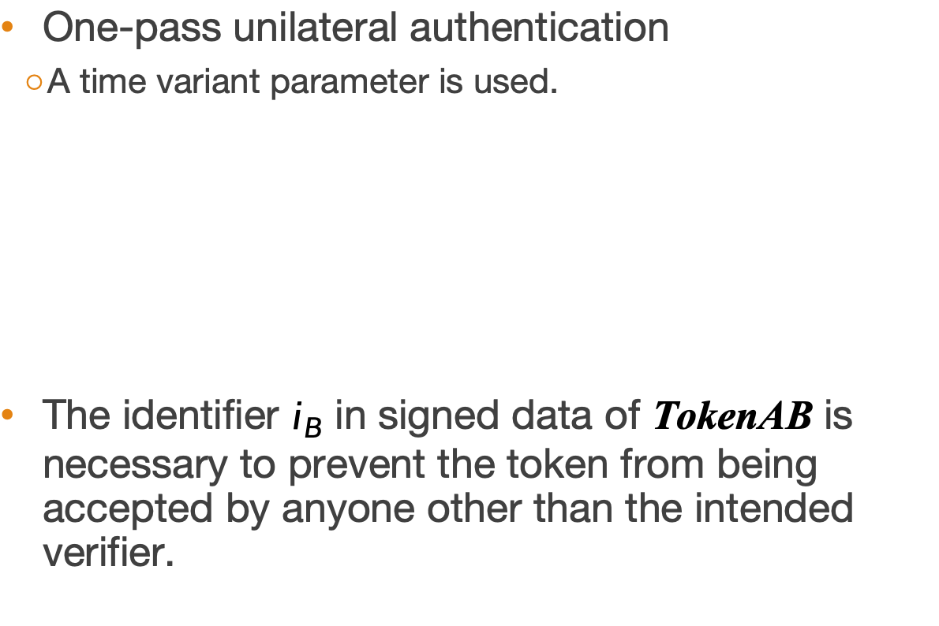
ISO/IEC 9798-3: UNI.TS
One-pass unilateral authentication
A time variant parameter is used.
The identifier $i_{B}$ in signed data of TokenAB is necessary to prevent the token from being accepted by anyone other than the intended verifier.
A
$$I_{A}||TokenAB$$
B
Protocol 7-1
1．A→B: I_{A}||TokenAB
I_{A} is optional.
$$TokenAB ={sS}_{A}\left({SID}_{UNI.TS}^{1}|\left|{TN}_{A}\right||i_{B}\right)$$

Slide 56



ISO/IEC 9798-3: UNI.CR
1. $R_{B}$
Two-pass unilateral authentication
A
B
2. $I_{A}||TokenAB$
Protocol 7-2
1．B→A: R_{B}
2．A→B: $I_{A}$||TokenAB
$I_{A}$ is optional.
$$TokenAB ={sS}_{A}\left({SID}_{UNI.CR}^{1}\left|\left|R_{A}\right|\right|R_{B}||i_{B}\right)$$
Notes:
fffffffffff

Slide 57

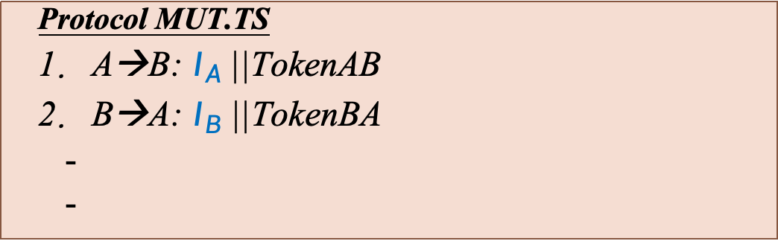



ISO/IEC 9798-3: MUT.TS
A
1. $I_{A}||TokenAB$
B
Two-pass mutual authentication
$I_{A}$, $I_{B}$ are optional
${TN}_{A}$ makes the two messages bounded to form a mutual authentication process.
2. $I_{B}||TokenBA$
Protocol MUT.TS
1．A→B: $I_{A}$||TokenAB
2．B→A: $I_{B}$||TokenBA
$$TokenAB ={sS}_{A}\left({SID}_{MUT.TS}^{1}\left|\left|{TN}_{A}\right|\right|i_{B}\right)$$
$$TokenBA ={sS}_{B}\left({SID}_{MUT.TS}^{2}\left|\left|{TN}_{B}||{TN}_{A}\right|\right|i_{A}\right)$$
Notes:
fffffffffffffff

Slide 58



ISO/IEC 9798-3: MUT.CR
1. $R_{B}$
A
B
2. $I_{A}||TokenAB$
3. $I_{B}||TokenBA$
Protocol MUT.CR
1． B→A: $R_{B}$
2. A→B: $I_{A}$||TokenAB
3．B→A: $I_{B}$||TokenBA
$$TokenAB ={sS}_{A}\left({SID}_{MUT.CR}^{1}\left|\left|R_{A}\right|\right|R_{B}||i_{B}\right)$$
$$TokenBA ={sS}_{B}\left({SID}_{MUT.CR}^{2}\left|\left|R_{B}^{′}\right|\right|R_{A}||i_{A}\right)$$
Notes:
fffffffffffff 标红

Slide 59






ISO/IEC 9798-3: MUT.CR.par
1.$I_{A}||R_{A}$
Two-pass parallel authentication
双方相互发起协议
A
B
1’.$I_{B}||R_{B}$
2. $TokenBA$
2’. $TokenAB$
Protocol MUT.CR.par
1. A→B: $I_{A}||R_{A}$
2. B→A: TokenBA
Protocol MUT.CR.par
1’. B→A: $I_{B}||R_{B}$
2’. A→B: TokenAB
$$TokenBA ={sS}_{B}\left({SID}_{MUT.CR.par}^{1}\left|\left|R_{B}\right|\right|R_{A}||i_{A}\right)$$
$$TokenAB ={sS}_{A}\left({SID}_{MUT.CR.par}^{1}\left|\left|R_{A}\right|\right|R_{B}||i_{B}\right)$$

Slide 60
ISO/IEC 9798-3: Protocols involving an online TTP
Unilateral authentication
Four-pass authentication TP.UNI.1 (initiated by A)
Four-pass authentication TP.UNI.2 (initiated by B)
Mutual authentication
Five-pass authentication TP.MUT.1 (initiated by A)
Five-pass authentication TP.MUT.2 (initiated by B)
Seven-pass authentication TP.MUT.2(initiated by B)
with two TTPs

Slide 61
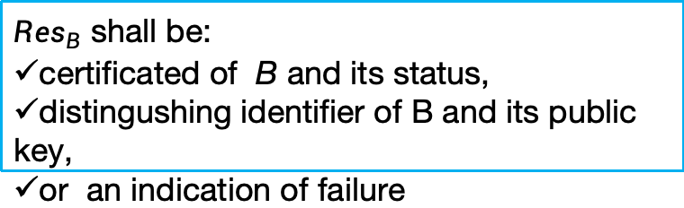





ISO/IEC 9798-3: TP.UNI.1
Four-pass authentication initiated by A
TP:
if $I_{B}=i_{B}$, retrieves $P_{B}$
if $I_{B}={Cert}_{B}$, verifies validity of ${Cert}_{B}$
Protocol TP.UNI.1
1.A→B: R_{A}
2.B→A: TokenBA
3. A→TP: R’_{A}||I_{B}
4. TP→A: TokenTA
$$TokenBA ={sS}_{B}\left({SID}_{TP.UNI.1}^{1}\left|\left|R_{B}\right|\right|R_{A}||i_{A}\right)$$
$$TokenTA ={sS}_{T}\left({SID}_{TP.UNI.1}^{2}\left|\left|R_{A}^{′}\right|\right|{Res}_{B}\right)$$
TP
3. $R_{A}^{′}$|| $I_{B}$
4.$TokenTA$
${Res}_{B}$ shall be:
certificated of B and its status,
distingushing identifier of B and its public key,
or an indication of failure
A
1. $R_{A}$
B
2.$TokenBA$
Notes:
TP需要根据消息中的IB查找对应的公钥完成签名验证

Slide 62



ISO/IEC 9798-3: TP.UNI.2
TP
Four-pass authentication initiated by B
2. $R_{B}$||$I_{A}$
3.$TokenTA$
Protocol TP.UNI.1
1.B→A: R_{B}
2.A→TP: R_{B}||I_{A}
3. TP→A: TokenTA
4. A→B: TokenAB
A
1. $R_{B}$
B
4.$TokenAB$
$$TokenTA ={sS}_{T}\left({SID}_{TP.UNI.2}^{1}\left|\left|R_{B}\right|\right|{Res}_{A}\right)$$
$$TokenAB =TokenTA||{sS}_{A}\left({SID}_{TP.UNI.2}^{2}\left|\left|R_{A}\right|\right|R_{B}||i_{B}\right)$$

Slide 63
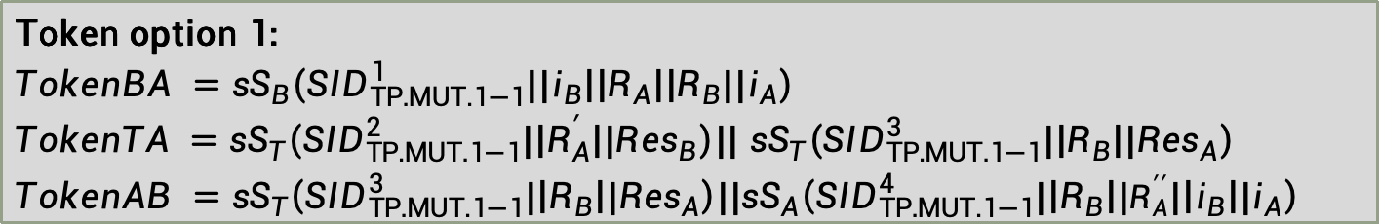





ISO/IEC 9798-3: TP.MUT.1(2-1)
Five-pass authentication initiated by A
Protocol TP.MUT.1
1.A→B: R_{A}||I_{A}
2.B→A: I_{B}||TokenBA
3. A→TTP: R’_{A}||R_{B}||I_{A}||I_{B}
4. TTP→A: TokenTA
5. A→B: TokenAB
TP
3. $R_{A}^{′}\left|\left|R_{B}\right|\right|I_{A}||I_{B}$
4.$Token$TA
1. $R_{A}||I_{A}$
A
B
2. $I_{B}||TokenBA$
5. $TokenAB$
Token option 1:
$$TokenBA ={sS}_{B}\left({SID}_{TP.MUT.1−1}^{1}||i_{B}\left|\left|R_{A}\right|\right|R_{B}||i_{A}\right)$$
$TokenTA ={sS}_{T}\left({SID}_{TP.MUT.1−1}^{2}|\left|R_{A}^{′}\right||{Res}_{B}\right)$|| ${sS}_{T}\left({SID}_{TP.MUT.1−1}^{3}|\left|R_{B}\right||{Res}_{A}\right)$
$$TokenAB ={sS}_{T}\left({SID}_{TP.MUT.1−1}^{3}|\left|R_{B}\right||{Res}_{A}\right)||{sS}_{A}\left({SID}_{TP.MUT.1−1}^{4}|\left|R_{B}\right||R_{A}^{′′}|\left|i_{B}\right||i_{A}\right)$$

Slide 64
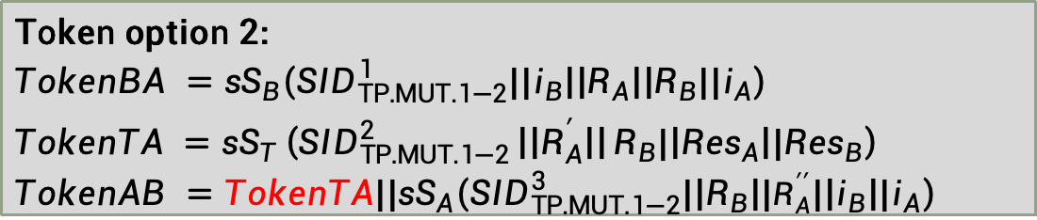
ISO/IEC 9798-3: TP.MUT.1(2-2)
Five-pass authentication initiated by A
Protocol TP.MUT.1
1.A→B: R_{A}||I_{A}
2.B→A: I_{B}||TokenBA
3. A→TTP: R’_{A}||R_{B}||I_{A}||I_{B}
4. TTP→A: TokenTA
5. A→B: TokenAB
TP
3. $R_{A}^{′}\left|\left|R_{B}\right|\right|I_{A}||I_{B}$
4.$Token$TA
1. $R_{A}||I_{A}$
A
B
2. $I_{B}||TokenBA$
5. $TokenAB$
Token option 2:
$$TokenBA ={sS}_{B}\left({SID}_{TP.MUT.1−2}^{1}||i_{B}\left|\left|R_{A}\right|\right|R_{B}||i_{A}\right)$$
$$TokenTA ={sS}_{T}\left({SID}_{TP.MUT.1−2}^{2}\left|\left|R_{A}^{′}\right|\right|R_{B}|\left|{Res}_{A}\right||{Res}_{B}\right)$$
$$TokenAB =TokenTA||{sS}_{A}\left({SID}_{TP.MUT.1−2}^{3}|\left|R_{B}\right||R_{A}^{′′}|\left|i_{B}\right||i_{A}\right)$$

Slide 65
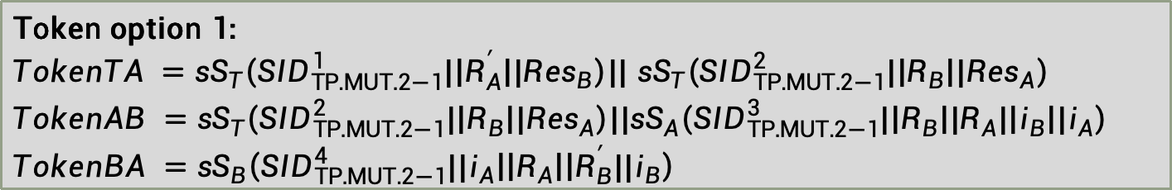





ISO/IEC 9798-3: TP.MUT.2(2-1)
Five-pass authentication initiated by B
Protocol TP.MUT.2
1.B→A: R_{B}||I_{B}
2. A→TTP: R’_{A}||R_{B}||I_{A}||I_{B}
3. TTP→A: TokenTA
4. A→B:I_{A}||TokenAB
5. B→A: TokenBA
TP
2. $R_{A}^{′}\left|\left|R_{B}\right|\right|I_{A}||I_{B}$
3.$Token$TA
1. $R_{B}||I_{B}$
A
B
4. $I_{A}||TokenAB$
5. $TokenBA$
Token option 1:
$TokenTA ={sS}_{T}\left({SID}_{TP.MUT.2−1}^{1}|\left|R_{A}^{′}\right||{Res}_{B}\right)$|| ${sS}_{T}\left({SID}_{TP.MUT.2−1}^{2}|\left|R_{B}\right||{Res}_{A}\right)$
$$TokenAB ={sS}_{T}\left({SID}_{TP.MUT.2−1}^{2}|\left|R_{B}\right||{Res}_{A}\right)||{sS}_{A}\left({SID}_{TP.MUT.2−1}^{3}|\left|R_{B}\right||R_{A}|\left|i_{B}\right||i_{A}\right)$$
$$TokenBA ={sS}_{B}\left({SID}_{TP.MUT.2−1}^{4}||i_{A}\left|\left|R_{A}\right|\right|R_{B}^{′}||i_{B}\right)$$

Slide 66
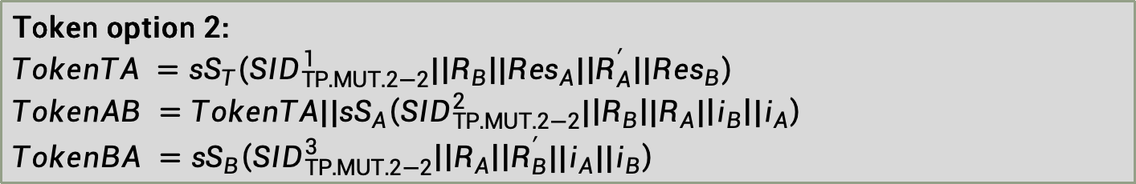
ISO/IEC 9798-3: TP.MUT.2(2-2)
Five-pass authentication initiated by B
Protocol TP.MUT.2
1.B→A: R_{B}||I_{B}
2. A→TTP: R’_{A}||R_{B}||I_{A}||I_{B}
3. TTP→A: TokenTA
4. A→B:I_{A}||TokenAB
5. B→A: TokenBA
TP
2. $R_{A}^{′}\left|\left|R_{B}\right|\right|I_{A}||I_{B}$
3.$Token$TA
1. $R_{B}||I_{B}$
A
B
4. $I_{A}||TokenAB$
5. $TokenBA$
Token option 2:
$$TokenTA ={sS}_{T}\left({SID}_{TP.MUT.2−2}^{1}|\left|R_{B}\right||{Res}_{A}|\left|R_{A}^{′}\right||{Res}_{B}\right)$$
$$TokenAB =TokenTA||{sS}_{A}\left({SID}_{TP.MUT.2−2}^{2}|\left|R_{B}\right||R_{A}|\left|i_{B}\right||i_{A}\right)$$
$$TokenBA ={sS}_{B}\left({SID}_{TP.MUT.2−2}^{3}\left|\left|R_{A}\right|\right|R_{B}^{′}||i_{A}||i_{B}\right)$$

Slide 67


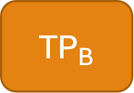





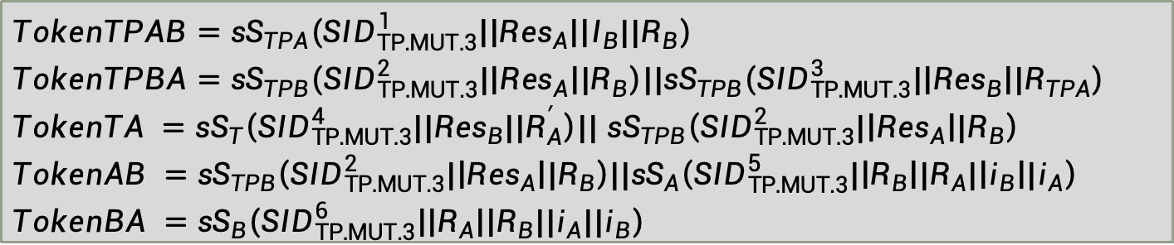

ISO/IEC 9798-3: TP.MTU.3
$${TP}_{A}$$
3. $R_{TPA}||TokenTPAB$
$${TP}_{B}$$
Seven-pass authentication
Two TTP
TPA knows A, and TPB knows B
TPA and TPB know each other
4.$TokenTPBA$
2. ${R′}_{A}\left|\left|R_{B}\right|\right|I_{A}||I_{B}$
5.$Token$TA
1. $R_{B}||I_{B}$
A
B
6. $TokenAB||I_{A}$
7. $TokenBA$
$$TokenTPAB={sS}_{TPA}\left({SID}_{TP.MUT.3}^{1}\left|\left|{Res}_{A}\right|\right|I_{B}||R_{B}\right)$$
$$TokenTPBA={sS}_{TPB}\left({SID}_{TP.MUT.3}^{2}|\left|{Res}_{A}\right||R_{B}\right)||{sS}_{TPB}\left({SID}_{TP.MUT.3}^{3}|\left|{Res}_{B}\right||R_{TPA}\right)$$
$TokenTA ={sS}_{T}\left({SID}_{TP.MUT.3}^{4}||{Res}_{B}||R_{A}^{′}\right)||$ ${sS}_{TPB}\left({SID}_{TP.MUT.3}^{2}|\left|{Res}_{A}\right||R_{B}\right)$
$$TokenAB ={sS}_{TPB}\left({SID}_{TP.MUT.3}^{2}|\left|{Res}_{A}\right||R_{B}\right)||{sS}_{A}\left({SID}_{TP.MUT.3}^{5}|\left|R_{B}\right||R_{A}|\left|i_{B}\right||i_{A}\right)$$
$$TokenBA ={sS}_{B}\left({SID}_{TP.MUT.3}^{6}\left|\left|R_{A}\right|\right|R_{B}||i_{A}||i_{B}\right)$$

